Slide 1
AWS Marketplace: Empowering Your Cloud Solutions
By Nimesh Dash

Slide 2
Introduction to AWS Marketplace
Definition: AWS Marketplace is a curated digital catalog that helps customers find, buy, deploy, and manage third-party software, data, and services to build solutions and run their businesses.
DOCS.AWS.AMAZON.COM

Slide 3

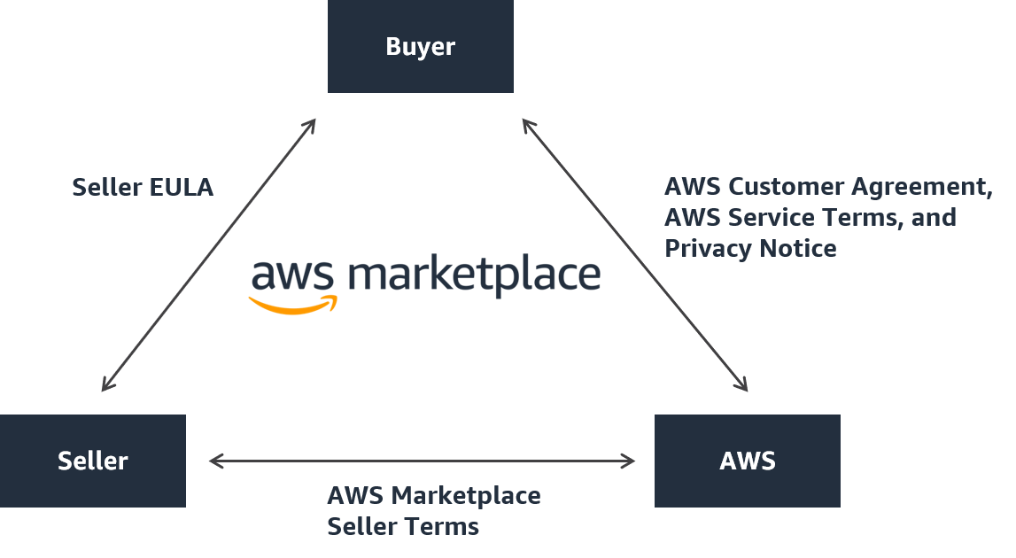
Visual Overview of AWS Marketplace

Slide 4
How AWS Marketplace Works
Follow The Steps :
Browse the catalog to discover software solutions.
Evaluate products through detailed information and user reviews.
Purchase and deploy directly through the AWS environment.
Emphasize the seamless integration with AWS billing and services.

Slide 5
Key Features of AWS Marketplace
Diverse Product Selection: Thousands of software listings across various categories.
Flexible Pricing Models: Options include free trials, hourly, monthly, annual, and multi-year subscriptions.
Simplified Deployment: Pre-configured software for quick launch.
Centralized Billing: Consolidated AWS billing for all purchases.

Slide 6
Benefits of Using AWS Marketplace
Streamlined Procurement: Faster software acquisition with standardized contracts.
Enhanced Governance: Centralized control over software usage and compliance.
Cost Optimization: Transparent pricing and consolidated billing aid in budget management.
Scalability: Easily find solutions that scale with your business needs.

Slide 7
Use Cases of AWS Marketplace
Security Solutions: Deploy firewall and threat detection software.
Data Analytics: Access tools for big data processing and visualization.
Machine Learning: Utilize pre-trained models and development frameworks.

Slide 8
Applications of AWS Marketplace
Business Applications: Implement CRM, ERP, and other enterprise solutions.
Data and Analytics: Data and Analytics Tools
DevOps: DevOps Tools
Infrastructure Software: Infrastructure Software Tools
Internet of Things (IoT): IoT Tools
Migration: Tools for migrating Data and Applications
Machine Learning: Machine Learning Tools
Security: Security Tools

Slide 9
Getting Started with AWS Marketplace
Steps to begin:
Sign in to your AWS account.
Navigate to the AWS Marketplace.
Browse and select products.
Review pricing and terms.
Deploy the chosen solution.

Slide 10
Conclusion
AWS Marketplace plays an Important role in simplifying software procurement and deployment.

